Slide 1


The PiXL Club The PiXL Club The PiXL Club The PiXL Club The PiXL Club The PiXL Club The PiXL Club The PiXL Club The PiXL Club The PiXL Club The PiXL Club The PiXL Club The PiXL Club The PiXL Club The PiXL Club The PiXL Club The PiXL Club The PiXL Club The PiXL Club The PiXL Club The PiXL Club The PiXL Club The PiXL Club The PiXL Club The PiXL Club The PiXL Club The PiXL Club The PiXL Club The PiXL Club The PiXL Club The PiXL Club The PiXL Club The PiXL Club The PiXL Club The PiXL Club The PiXL Club The PiXL Club The PiXL Club The PiXL Club The PiXL Club The PiXL Club The PiXL Club The PiXL Club The PiXL Club The PiXL Club XL Club The PiXL Club The PiXL Club The PiXL Club The PiXL Club The PiXL Club The PiXL Club The PiXL Club The PiXL Club The PiXL Club The PiXL Club The PiXL Club The PiXL Club The PiXL Club The PiXL Club The PiXL Club The PiXL Club The PiXL Club The PiXL Club The PiXL Club The PiXL Club The PiXL Club The PiXL Club The PiXL Club The PiXL Club The PiXL Club The PiXL Club The PiXL Club The PiXL Club The PiXL Club The PiXL Club The PiXL Club The PiXL Club The PiXL Club The PiXL Club The PiXL Club The PiXL Club The PiXL Club The PiXL Club The PiXL Club The PiXL Club The PiXL Club The PiXL Club The PiXL Club The PiXL Club The PiXL Club The PiXL Club The PiXL Club The PiXL Club The PiXL Club The PiXL Club The PiXL Club The PiXL Club The PiXL Club The PiXL Club The PiXL Club The PiXL Club The PiXL Club The PiXL Club The PiXL Club The PiXL Club The PiXL Club The PiXL Club The PiXL Club The PiXL Club The PiXL Club The PiXL Club The PiXL Club The PiXL Club The PiXL Club The PiXL Club The PiXL Club The PiXL Club The PiXL Club The PiXL Club The PiXL Club The PiXL Club The PiXL Club The PiXL Club The PiXL Club The PiXL Club The PiXL Club The PiXL Club The PiXL Club The PiXL Club The PiXL Club The PiXL Club The PiXL Club The PiXL Club The PiXL Club The PiXL Club The PiXL Club The PiXL Club The PiXL Club The PiXL Club The PiXL Club The PiXL Club The PiXL Club The PiXL Club The PiXL Club The PiXL Club The PiXL Club The PiXL Club The PiXL Club The PiXL Club The PiXL Club The PiXL Club The PiXL Club The PiXL Club The PiXL Club The PiXL Club The PiXL Club The PiXL Club The PiXL Club The PiXL Club The PiXL Club The PiXL Club The PiXL Club The PiXL Club The PiXL Club The PiXL Club The PiXL Club The PiXL Club The PiXL Club The PiXL Club The PiXL Club The PiXL Club The PiXL Club The PiXL Club The PiXL Club The PiXL Club The PiXL Club The PiXL Club The PiXL Club The PiXL Club The PiXL Club The PiXL Club The PiXL Club The PiXL Club The PiXL Club The PiXL Club The PiXL Club The PiXL Club The PiXL Club The PiXL Club The PiXL Club The PiXL Club The PiXL Club The PiXL Club The PiXL Club The PiXL Club The PiXL Club The PiXL Club The PiXL Club The PiXL Club The PiXL Club The PiXL Club The PiXL Club The PiXL Club The PiXL Club The PiXL Club The PiXL Club The PiXL Club The PiXL Club The PiXL Club The PiXL Club The PiXL Club The PiXL Club The PiXL Club The PiXL Club The PiXL Club The PiXL Club The PiXL Club The PiXL Club The PiXL Club The PiXL Club The PiXL Club The PiXL Club The PiXL Club The PiXL Club The PiXL Club The PiXL Club The PiXL Club The PiXL Club The PiXL Club The PiXL Club The PiXL Club The PiXL Club The PiXL Club The PiXL Club The PiXL Club The PiXL Club The PiXL Club The PiXL Club The PiXL Club The PiXL Club The PiXL Club The PiXL Club The PiXL Club The PiXL Club The PiXL Club The PiXL Club The PiXL Club The PiXL Club The PiXL Club The PiXL Club The PiXL Club The PiXL Club The PiXL Club The PiXL Club The PiXL Club The PiXL Club The PiXL Club The PiXL Club The PiXL Club The PiXL Club The PiXL Club The PiXL Club The PiXL Club The PiXL Club The PiXL Club The PiXL Club The PiXL Club The PiXL Club The PiXL Club The PiXL Club The PiXL Club The PiXL Club The PiXL Club The PiXL Club The PiXL Club The PiXL Club The PiXL Club The PiXL Club The PiXL Club The PiXL Club The PiXL Club The PiXL Club The PiXL Club The PiXL Club The PiXL Club The PiXL Club The PiXL Club The PiXL Club The PiXL Club The PiXL Club The PiXL Club The PiXL Club The PiXL Club The PiXL Club The PiXL Club The PiXL Club The PiXL Club The PiXL Club The PiXL Club The PiXL Club The PiXL Club The PiXL Club The PiXL Club The PiXL Club The PiXL Club The PiXL Club The PiXL Club The PiXL Club The PiXL Club The PiXL Club The PiXL Club The PiXL Club The PiXL Club The PiXL Club The PiXL Club The PiXL Club The PiXL Club The PiXL Club The PiXL Club The PiXL Club The PiXL Club The PiXL Club The PiXL Club The PiXL Club The PiXL Club The PiXL Club The PiXL Club The PiXL Club The PiXL Club The PiXL Club The PiXL Club The PiXL Club The PiXL Club The PiXL Club The PiXL Club The PiXL Club The PiXL Club The PiXL Club The PiXL Club The PiXL Club The PiXL Club The PiXL Club The PiXL Club The PiXL Club The PiXL Club The PiXL Club The PiXL Club The PiXL Club The PiXL Club The PiXL Club The PiXL Club The PiXL Club The PiXL Club The PiXL Club The PiXL Club The PiXL Club The PiXL Club The PiXL Club The PiXL Club The PiXL Club The PiXL Club The PiXL Club The PiXL Club The PiXL Club The PiXL Club The PiXL Club The PiXL Club The PiXL Club The PiXL Club The PiXL Club The PiXL Club The PiXL Club The PiXL Club The PiXL Club The PiXL Club The PiXL Club The PiXL Club The PiXL Club The PiXL Club The PiXL Club The PiXL Club The PiXL Club The PiXL Club The PiXL Club The PiXL Club The PiXL Club The PiXL Club The PiXL Club The PiXL Club The PiXL Club The PiXL Club The PiXL Club The PiXL Club The PiXL Club The PiXL Club The PiXL Club The PiXL Club The PiXL Club The PiXL Club The PiXL Club The PiXL Club The PiXL Club The PiXL Club The PiXL Club The PiXL Club The PiXL Club The PiXL Club The PiXL Club The PiXL Club The PiXL Club The PiXL Club The PiXL Club The PiXL Club The PiXL Club The PiXL Club The PiXL Club The PiXL Club The PiXL Club The PiXL Club The PiXL Club The PiXL Club The PiXL Club The PiXL Club The PiXL Club The PiXL Club The PiXL Club The PiXL Club The PiXL Club The PiXL Club The PiXL Club The PiXL Club The PiXL Club The PiXL Club The PiXL Club The PiXL Club The PiXL Club The PiXL Club The PiXL Club The PiXL Club The PiXL Club The PiXL Club The PiXL Club The PiXL Club The PiXL Club The PiXL Club The PiXL Club The PiXL Club The PiXL Club The PiXL Club The PiXL Club The PiXL Club The PiXL Club The PiXL Club The PiXL Club The PiXL Club The PiXL Club The PiXL Club The PiXL Club The PiXL Club The PiXL Club The PiXL Club The PiXL Club The PiXL Club The PiXL Club The PiXL Club The PiXL Club The PiXL Club The PiXL Club The PiXL Club The PiXL Club The PiXL Club The PiXL Club The PiXL Club The PiXL Club The PiXL Club The PiXL Club The PiXL Club The PiXL Club The PiXL Club The PiXL Club The PiXL Club The PiXL Club The PiXL Club The PiXL Club The PiXL Club The PiXL Club The PiXL Club The PiXL Club The PiXL Club The PiXL Club The PiXL Club The PiXL Club The PiXL Club The PiXL Club The PiXL Club The PiXL Club The PiXL Club The PiXL Club The PiXL Club The PiXL Club The PiXL Club The PiXL Club The PiXL Club The PiXL Club The PiXL Club The PiXL Club The PiXL Club The PiXL Club The PiXL Club The PiXL Club The PiXL Club The PiXL Club The PiXL Club The PiXL Club The PiXL Club The PiXL Club The PiXL Club The PiXL Club The PiXL Club The PiXL Club The PiXL Club The PiXL Club The PiXL Club The PiXL Club The PiXL Club The PiXL Club The PiXL Club The PiXL Club The PiXL Club The PiXL Club The PiXL Club The PiXL Club The PiXL Club The PiXL Club The PiXL Club The PiXL Club The PiXL Club The PiXL Club The PiXL Club The PiXL Club The PiXL Club The PiXL Club The PiXL Club The PiXL Club The PiXL Club The PiXL Club The PiXL Club The PiXL Club The PiXL Club The PiXL Club The PiXL Club The PiXL Club The PiXL Club The PiXL Club The PiXL Club The PiXL Club The PiXL Club The PiXL Club The PiXL Club The PiXL Club The PiXL Club The PiXL Club The PiXL Club The PiXL Club The PiXL Club The PiXL Club The PiXL Club The PiXL Club The PiXL Club The PiXL Club The PiXL Club The PiXL Club The PiXL Club The PiXL Club The PiXL Club The PiXL Club The PiXL Club The PiXL Club The PiXL Club The PiXL Club The PiXL Club The PiXL Club The PiXL Club The PiXL Club The PiXL Club The PiXL Club The PiXL Club The PiXL Club The PiXL Club The PiXL Club The PiXL Club The PiXL Club The PiXL Club The PiXL Club The PiXL Club The PiXL Club The PiXL Club The PiXL Club The PiXL Club The PiXL Club The PiXL Club The PiXL Club The PiXL Club The PiXL Club The PiXL Club The PiXL Club The PiXL Club The PiXL Club The PiXL Club The PiXL Club The PiXL Club The PiXL Club The PiXL Club The PiXL Club The PiXL Club The PiXL Club The PiXL Club The PiXL Club The PiXL Club The PiXL Club The PiXL Club The PiXL Club The PiXL Club The PiXL Club The PiXL Club The PiXL Club The PiXL Club The PiXL Club The PiXL Club The PiXL Club The PiXL Club The PiXL Club The PiXL Club The PiXL Club The PiXL Club The PiXL Club The PiXL Club The PiXL Club The PiXL Club The PiXL Club The PiXL Club The PiXL Club The PiXL Club The PiXL Club The PiXL Club The PiXL Club The PiXL Club The PiXL Club The PiXL Club The PiXL Club The PiXL Club The PiXL Club The PiXL Club The PiXL Club The PiXL Club The PiXL Club The PiXL Club The PiXL Club The PiXL Club The PiXL Club The PiXL Club The PiXL Club The PiXL Club The PiXL Club The PiXL Club The PiXL Club The PiXL Club The PiXL Club The PiXL Club The PiXL Club The PiXL Club The PiXL Club The PiXL Club The PiXL Club The PiXL Club The PiXL Club The PiXL Club The PiXL Club The PiXL Club The PiXL Club The PiXL Club The PiXL Club The PiXL Club The PiXL Club The PiXL Club The PiXL Club The PiXL Club The PiXL Club The PiXL Club The PiXL Club The PiXL Club The PiXL Club The PiXL Club The PiXL Club The PiXL Club The PiXL Club The PiXL Club The PiXL Club The PiXL Club The PiXL Club The PiXL Club The PiXL Club The PiXL Club The PiXL Club The PiXL Club The PiXL Club The PiXL Club The PiXL Club The PiXL Club The PiXL Club The PiXL Club The PiXL Club The PiXL Club The PiXL Club The PiXL Club The PiXL Club The PiXL Club The PiXL Club The PiXL Club The PiXL Club The PiXL Club The PiXL Club The PiXL Club The PiXL Club The PiXL Club The PiXL Club The PiXL Club The PiXL Club The PiXL Club The PiXL Club The PiXL Club The PiXL Club The PiXL Club The PiXL Club The PiXL Club The PiXL Club The PiXL Club The PiXL Club The PiXL Club The PiXL Club The PiXL Club The PiXL Club The PiXL Club The PiXL Club The PiXL Club
PiXL KnowIT!
GCSE Chemistry
Edexcel Topic – Extracting metals and equilibria
© Copyright The PiXL Club Ltd, 2017
This resource is strictly for the use of member schools for as long as they remain members of The PiXL Club. It may not be copied, sold nor transferred to a third party or used by the school after membership ceases. Until such time it may be freely used within the member school.
All opinions and contributions are those of the authors. The contents of this resource are not connected with nor endorsed by any other company, organisation or institution.
www.pixl.org.uk The PiXL Club Ltd, Company number 07321607

Slide 2
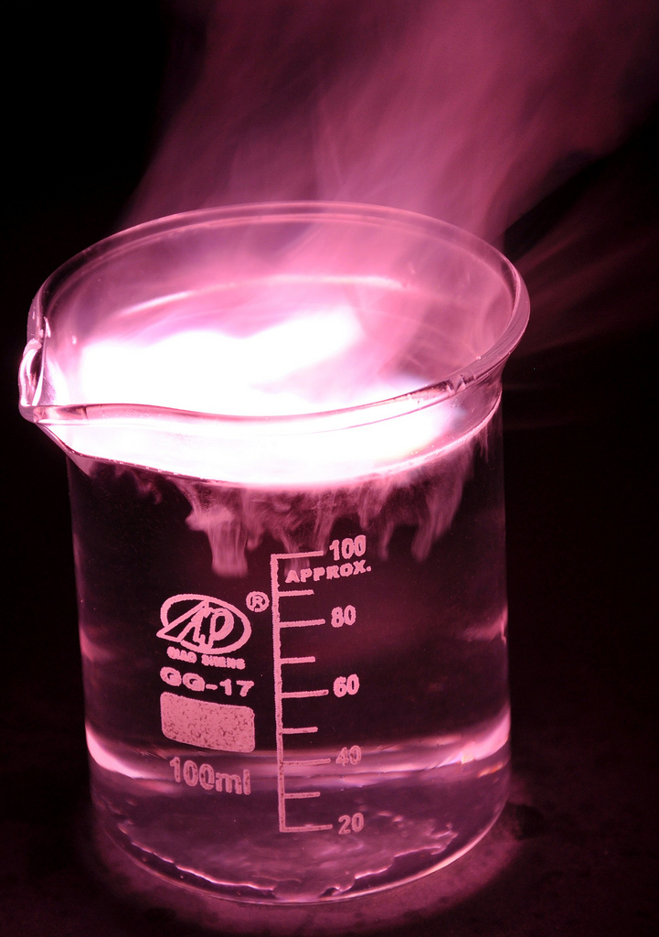
Overview Extracting metals and equilibria
Obtaining and using metals
Reactivity series
Displacement reactions as redox reactions (HT)
Metal ores
Oxidation and reduction
Biological methods of extraction
Recycling metals
Life-cycle assessment
Reversible reactions and equilibria
Reversible reactions
Dynamic equilibrium
The Haber Process
Factors affecting dynamic equilibria (HT)
Notes:
https://c2.staticflickr.com/4/3178/4076380768_03994aed44_b.jpg

Slide 3

LearnIT!
KnowIT!
Reactivity of metals
Reactivity series
Displacement reactions as redox reactions (HT)

Slide 4
Reactivity series
Metals can be arranged in order of reactivity in a reactivity series.
Order of reactivity | Reaction with water | Reaction with acid
Potassium | Fizz, giving off hydrogen gas and leaving an alkaline solution of metal hydroxide | Reacts violently and explodes
Sodium
Lithium
Calcium |  | Fizz, giving off hydrogen gas and forming a salt
Magnesium | Very slow reaction
Aluminium
Zinc
Iron
Tin | No reaction with water at room temperature | React slowly with warm acid
Lead
Copper | No reaction | No reaction
Silver
Gold

Slide 5
Reactivity series
Metals can be arranged in order of reactivity in a reactivity series.
When metals react with other substances the metal atoms form positive ions called CATIONS.
The reactivity of a metal is linked to its tendency to form cations.
The non-metals hydrogen and carbon are often included in the series as they can be used to extract less reactive metals.
metal + acid → salt + hydrogen
Increasing reactivity
Potassium
Sodium
Lithium
Calcium
Magnesium
CARBON
Zinc
Iron
Lead
HYDROGEN
Copper
Silver
Gold

Slide 6
Oxidation and reduction in terms of electrons (HT)
Higher:
OILRIG
Oxidation Is Loss of electrons
Reduction Is Gain of electrons
When reactions involve oxidation and reduction, they are known as redox reactions
A more reactive metal can displace a less reactive metal
from its compound in displacement reactions.
Iron + copper(II) sulfate → iron sulfate + copper
Fe(s) + CuSO₄(aq) → FeSO₄(aq) + Cu(s)
Higher:
An ionic equation shows only the atoms and ions that change in a reaction:
Fe(s) + Cu²⁺(aq) → Fe²⁺(aq) + Cu(s)
Half equations show what happens to each reactant:
Fe → Fe ²⁺ + 2e –
Cu ²⁺ + 2e – → Cu
The iron atoms are oxidised (lose 2 electrons) to form ions.
The 2 electrons from the iron are gained (reduction) by copper ions as they become atoms.

Slide 7

QuestionIT!
Reactivity of metals
Reactivity series
Displacement reactions as redox reactions (HT)

Slide 8
Extracting metals – QuestionIT
Place these metals in order of their reactivity:
Potassium, silver, copper, magnesium
Name the two non-metals in the reactivity series.
Metals form positive ions. What is the scientific name for these positive ions?
Why is gold found in the Earth as an element rather than a compound?

Slide 9
Extracting metals – QuestionIT
HT – What is a redox reaction?
HT – Describe oxidation in terms of electrons.
HT – Describe reduction in terms of electrons.

Slide 10

AnswerIT!
Reactivity of metals
Reactivity series
Displacement reactions as redox reactions (HT)

Slide 11
Extracting metals – QuestionIT
Place these metals in order of their reactivity:
Potassium, silver, copper, magnesium
Highest: Potassium, magnesium, copper, silver: lowest
Name the two non-metals in the reactivity series.
Carbon and hydrogen
Metals form positive ions. What is the scientific name for these positive ions?
Cations
Why is gold found in the Earth as an element rather than a compound?
It is very unreactive.

Slide 12
Extracting metals – QuestionIT
HT – What is a redox reaction?
Reaction involving both oxidation and reduction.
HT – Describe oxidation in terms of electrons.
OIL – oxidation is loss of electrons.
HT – Describe reduction in terms of electrons.
RIG – reduction is gain of electrons.

Slide 13
LearnIT!
KnowIT!
Extracting metals
Metal ores
Oxidation and reduction
Methods of extraction
Biological methods of extraction (HT)

Slide 14
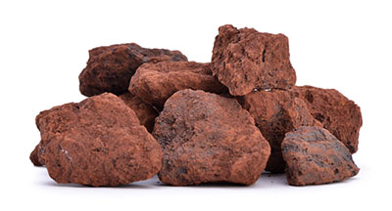
Metal Oxides, oxidation and reduction
A metal compound within a rock is an ore. Ores are mined and then purified. Unreactive metals are found in the Earth’s crust as uncombined elements.
Whether it is worth extracting a particular metal depends on:
How easy it is to extract it from its ore
How much metal the ore contains
The changing demands for a particular metal
Most metals in ores are chemically bonded to other elements in compounds. Many of these metals have been oxidised (have oxygen added) by oxygen in the air to form their oxides.
Iron + oxygen → iron (III) oxide
4Fe(s) + 3O₂(g) → 2Fe₂O₃(s)
To extract metals from their oxides, the metal oxides must be reduced (have oxygen removed).

Slide 15
Extracting metals
The reactivity of a metal determines the method of extraction.
A metal’s relative resistance to oxidation is related to its position in the reactivity series.
Metals above carbon must be extracted from their ores using electrolysis.
Metals below carbon can be extracted from their ores by reduction using carbon.
REDUCTION involves the loss of oxygen.
metal oxide + carbon → metal + carbon dioxide
Potassium
Sodium
Calcium
Magnesium
Aluminium
CARBON
Increasing reactivity
Zinc
Iron
Lead
HYDROGEN
Copper
Silver
Gold
Platinum
Gold and silver do not need to be extracted.
They occur native (naturally).

Slide 16
Extracting metals
Metals can be extracted from molten compounds using electrolysis.
It is used if the metal is too reactive to be extracted by reduction with carbon or if the metal reacts with carbon.
Large amounts of energy are used in the extraction process to melt the compounds and to produce the electrical current.
Aluminum is manufactured by electrolysis of molten aluminum oxide.
aluminium oxide → aluminium + oxygen
Aluminium oxide has a very high melting point so is mixed with molten cryolite to lower the temperature required to carry out the electrolysis.
Aluminium goes to the negative electrode and sinks to bottom.
Higher: Al ³⁺ + 3e – → Al
Oxygen forms at positive electrodes.
Higher: 2O ²⁻ → O₂ + 4e –
The oxygen reacts with the carbon electrode making carbon dioxide and causing damage. The electrode needs replacing due to this reaction.
C + O₂ → CO₂
Graphite anodes + charge
Steel case
+
+
+
-
-
-
Graphite cathode - charge
Molten aluminium oxide with
cryolite 950 ºC
Molten aluminium
Notes:
https://www.google.co.uk/url?sa=i&rct=j&q=&esrc=s&source=images&cd=&cad=rja&uact=8&ved=0ahUKEwi0wPOphtDVAhUIShQKHW9XD0AQjRwIBw&url=http%3A%2F%2Fibchem.com%2FIB%2Fibnotes%2Ffull%2Fope_htm%2Fhall_cell.htm&psig=AFQjCNGb7-GPpBasXBz55VXk3BCbdFEYPQ&ust=1502570727717402

Slide 17
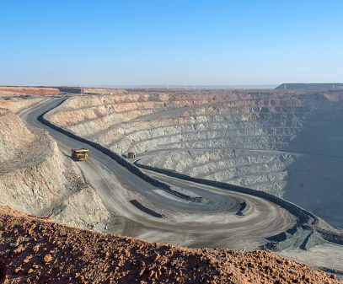
Alternative biological methods of metal extraction (HT only)
The Earth’s resources of metal ores are limited.
The damage done by mining can be seen in the picture on the right, showing a lot of waste produced. The copper ore being mined recently contains less and less copper
Copper ores are becoming scarce. New ways of extracting copper from low-grade ores include phytomining and bioleaching. These methods avoid traditional mining methods of digging, moving and disposing of large amounts of rock.
Phytomining uses plants to absorb metal compounds (often from the waste from previous mining). The plants are harvested and then burned to produce ash that contains metal compounds.
Bioleaching uses bacteria to produce leachate solutions that contain (dissolved) metal compounds. The metal compounds can be processed to obtain the metal. For example, copper can be obtained from solutions of copper compounds by displacement using scrap iron or by electrolysis.

Slide 18
QuestionIT!
Extracting metals – Part 1
Metal ores
Oxidation and reduction
Methods of extraction
Biological methods of
extraction (HT)

Slide 19
Extracting metals – QuestionIT
What is an ore?
What is produced when metals react with oxygen?
What is this process called and why?
What is reduction in terms of oxygen?
What type of ions do metals produce?
Which is more reactive, potassium or iron?
Which two non-metals can be included in the reactivity series?

Slide 20
Extracting metals – QuestionIT
Why is gold found as an element in the Earth?
How are metals, less reactive than carbon, extracted from their ores?
HT: Describe oxidation in terms of electrons.
HT: Describe reduction in terms of electrons.
Write the word equation for the reaction between lithium and water.

Slide 21
Extracting metals – QuestionIT
Write the balanced symbol equation for the reaction between lithium and water.
HT: Zinc can be extracted from zinc oxide by heating it with carbon in the blast furnace. Carbon monoxide is also produced. Which reactant is:
a) Oxidised?
b) Reduced?
Why is electrolysis used to extract aluminium from its ore?
Why is electrolysis an expensive way to extract metal from its ore?
Name the compound from which aluminium is extracted.

Slide 22
Alternative methods of extracting metals (HT only)- AnswerIT
What type of ores can phytomining and bioleaching be used on?
Why are phytomining and bioleaching used?
How does phytomining extract metals?

Slide 23
AnswerIT!
Extracting metals –
Part 1
Metal ores
Oxidation and reduction
Methods of extraction
Biological methods of
extraction (HT)

Slide 24
Extracting metals – QuestionIT
What is an ore?
Metal compound in a rock.
What is produced when metals react with oxygen?
Metal oxide.
What is this process called and why?
Oxidation, gain of oxygen.
What is reduction in terms of oxygen?
Loss of oxygen.
What type of ions do metals produce?
Positive.
Which is more reactive, potassium or iron?
Potassium.
Which two non-metals can be included in the reactivity series?
Carbon and hydrogen.

Slide 25
Extracting metals – QuestionIT
Why is gold found as an element in the Earth?
Unreactive metal.
How are metals, less reactive than carbon, extracted from their ores?
Reduction with carbon.
HT: Describe oxidation in terms of electrons.
OIL – loss of electrons
HT: Describe reduction in terms of electrons.
RIG – gain of electrons
Write the word equation for the reaction between lithium and water.
lithium + water → lithium hydroxide + hydrogen

Slide 26
Extracting metals – QuestionIT
Write the balanced symbol equation for the reaction between lithium and water.
2Li(s) + 2H₂O(l) → 2LiOH(aq) + H₂(g)
HT: Zinc can be extracted from zinc oxide by heating it with carbon in the blast furnace. Carbon monoxide is also produced. Which reactant is:
a) Oxidised? Carbon
b) Reduced? Zinc oxide

Slide 27
Electrolysis – QuestionIT
Why is electrolysis used to extract aluminium from its ore?
Aluminium is more reactive than carbon.
Why is electrolysis an expensive way to extract metal from its ore?
Large amounts of energy needed.
Name the compound from which aluminium is extracted.
Aluminium oxide/ bauxite.
What type of ores can phytomining and bioleaching be used on?
Low-grade ores
Why are phytomining and bioleaching used?
Avoids traditional mining methods of
digging, moving and disposing of large amounts of rock
How does phytomining extract metals?
Uses plants to absorb metal compounds,
the plants are harvested and burned,
this produces ash that contains metal compounds.

Slide 28
LearnIT!
KnowIT!
Extracting metals –
Part 2
Recycling metals
Life-cycle assessment

Slide 29
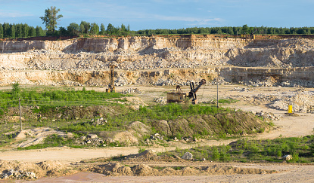


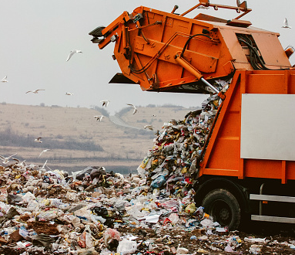
Life cycle assessments
Life cycle assessments (LCA’s) are carried out to assess the environmental impact of products in each of these stages.
Obtaining the raw materials
Manufacturing and packaging
Uses and operation during it’s
lifetime
Disposal at the end of it’s useful life, including transport and distribution at each stage

Slide 30

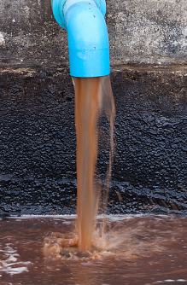
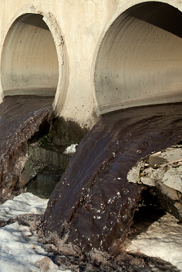
Life cycle assessments
Use of water, resources, energy sources and production of some wastes can be fairly easily quantified. Allocating numerical values to pollutant effects is less straightforward and requires value judgements, so life cycle assessment is not a purely objective process.
Selective or abbreviated life cycle assessments can be devised to evaluate a product but these can be misused to reach pre-determined conclusions, e.g. in support of claims for advertising purposes.

Slide 31
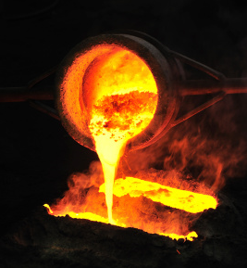

Recycling metals
Metals can be recycled by melting and recasting or reforming into different products.
Advantages of recycling metals:
Cheaper than extracting from their ores
Preserves the environment by reducing the environmental impact of mining
Avoids the need for mining as metal ores are a finite resource.

Slide 32
QuestionIT!
Extracting metals –
Part 2
Recycling metals
Life-cycle assessment

Slide 33
Extracting metals – Part 2 - QuestionIT
What is a life cycle assessment?
Life cycle assessments are carried out to assess the environmental impact of what stages of a product?
What areas of life cycle assessments can be easily quantified?
How can metals be recycled?
What are three advantages of recycling metals?

Slide 34
AnswerIT!
Extracting metals –
Part 2
Recycling metals
Life-cycle assessment

Slide 35
Extracting metals – Part 2 - QuestionIT
What is a life-cycle assessment?
Considering the impact on the environment for a product; in the lifetime of the product.
Life cycle assessments are carried out to assess the environmental impact. What stages of a product are covered?
Obtaining the raw materials
Manufacturing the product
Using the product
Disposal of the product.
What areas of life cycle assessments can be easily quantified?
Use of water, resources, energy and waste production.
How can metals be recycled?
Melting, recasting or reforming.
What are three advantages of recycling metals?
Cheaper, reduced environmental impact, avoids need for mining.

Slide 36
LearnIT!
KnowIT!
Reversible reactions and equilibria – Part 1
Reversible reactions
Dynamic equilibrium
Haber process

Slide 37

Reversible reactions and dynamic equilibrium
In some chemical reactions, the products of the reaction can react to produce the original reactants. Such reactions are called reversible reactions and are represented by:
A + B C + D
This is different to the usual → or = sign, which signify that all the reactants change to products in the reaction. In reversible reactions, there are always some reactants and some products.
The direction of reversible reactions can be changed by changing the reaction conditions.
When a reversible reaction occurs in apparatus which prevents the escape of reactants and products (a closed system), dynamic equilibrium is reached as the rate of the forward and reverse reactions occur at exactly the same rate.

Slide 38
The Haber process
The production of ammonia is a reversible reaction that can reach a dynamic equilibrium:
3H₂ + N₂ 2NH₃
The reactants for the reaction come from the following:
Nitrogen is extracted from the air
Hydrogen is obtained from natural gas
The conditions for the Haber process are:
A temperature of 450ºC
A pressure of 200 atmospheres
An iron catalyst

Slide 39
QuestionIT!
Reversible reactions and equilibria – Part 1
Reversible reactions
Dynamic equilibrium
Haber process

Slide 40
Reversible reactions QuestionIT
What is meant by a reversible reaction?
Draw the symbol for a reversible reaction.
What is meant by the term dynamic equilibrium?
What needs to happen for equilibrium to be reached?

Slide 41
Reversible reactions QuestionIT
The formation of ammonia is a reversible reaction between nitrogen and hydrogen. Where are these reactants extracted from?
Name the three conditions for the Haber process.

Slide 42
AnswerIT!
Reversible reactions and equilibria – Part 1
Reversible reactions
Dynamic equilibrium
Haber process

Slide 43
Reversible reactions QuestionIT
What is meant by a reversible reaction?
The reaction can occur in either direction.
Draw the symbol for a reversible reaction.
What is meant by the term dynamic equilibrium?
Rate of forward and reverse reactions occur at the same rate.
What needs to happen for equilibrium to be reached?
Needs to be in a closed system; products and reactants can not escape.

Slide 44
Reversible reactions QuestionIT
The formation of ammonia is a reversible reaction between nitrogen and hydrogen. Where are these reactants extracted from?
Hydrogen from natural gas; nitrogen from the air.
Name the three conditions for the Haber process.
Temperature – 450ºC; Pressure – 200 atmospheres; iron catalyst

Slide 45
LearnIT!
KnowIT!
Reversible reactions and equilibria – Part 2
Factors affecting dynamic equilibria (HT)

Slide 46
Factors affecting dynamic equilibrium (HT)
The Effect of Changing Concentration
If the concentration of one of the reactants or products is changed, the system is no longer at equilibrium and the concentrations of all the substances will change until equilibrium is reached again.
E.g. the Haber process equilibrium:
N₂ (g) + 3H₂ (g) 2NH₃(g)
If the concentration of a reactant is increased, more products will be formed until equilibrium is reached again.
If the concentration of a product is decreased, more reactants will react until equilibrium is reached again.

Slide 47
Factors affecting dynamic equilibrium (HT)
The Effect of Changing Temperature
If the temperature of a system at equilibrium is increased:
The relative amount of products at equilibrium increases for an endothermic reaction.
The relative amount of products at equilibrium decreases for an exothermic reaction.
If the temperature of a system at equilibrium is decreased:
The relative amount of products at equilibrium decreases for an endothermic reaction.
The relative amount of products at equilibrium increases for an exothermic reaction.
If we apply these to the equation below:
N₂ (g) + 3H₂ (g) 2NH₃ (g)
exothermic
endothermic
Increasing the temperature will give more nitrogen N₂ and hydrogen H₂ and less ammonia NH_{3.}
Decreasing the temperature the opposite result occurs- we would get more ammonia NH₃ and less nitrogen N₂ and hydrogen H_{2.}

Slide 48
Factors affecting dynamic equilibrium (HT)
The Effect of Changing Pressure
For gaseous reactions at equilibrium:
An increase in pressure causes the equilibrium position to shift towards the side with the smaller number of molecules, as shown by the symbol equation for that reaction.
A decrease in pressure causes the equilibrium position to shift towards the side with
larger number of molecules, as shown by the symbol equation for that reaction.
As 1 mole of gas at STP occupies 24 dm³, we can apply this knowledge to the equation.
N₂ (g) + 3H₂ (g) 2NH₃ (g)
There are 4 moles of reactants: 1 mole of nitrogen N₂ and 3 moles of H₂
There are only 2 moles of the ammonia NH₃ product.
The reactants will have 96 dm³ at STP and the products will only occupy 48 dm³ .
So if we increase the pressure, the equilibrium position will shift towards the right hand side simply because the two moles of ammonia take up a smaller volume. So, making more of the product that has less volume reduces the pressure that we have just increased.

Slide 49
QuestionIT!
Reversible reactions and equilibria – Part 2
Factors affecting dynamic equilibria (HT)

Slide 50
The Effect of changing conditions on equilibrium (HT only)QuestionIT
What three factors can be changed in a system at equilibrium?
If the concentration of a reactant is increased what will happen to the products of the reaction?
What will happen to the amount of product in an endothermic reaction at equilibrium if the temperature is increased?
What will happen to the amount of product in an exothermic reaction at equilibrium if the temperature is increased?

Slide 51
The Effect of changing conditions on equilibrium (HT only)QuestionIT
What will happen to the amount of product in an endothermic reaction at equilibrium if the temperature is decreased?
What is meant by the term ‘gaseous reaction’?
What would happen to the position of equilibrium in a gaseous reaction if the pressure is increased?
Explain what will happen in the following reaction if we increase the concentration of the hydrogen and iodine?
I₂ (g) + H₂ (g) 2HI (g)

Slide 52
Fuel Cells (Chemistry only)AnswerIT
What will happen if we increase the temperature of the reaction below? Explain why you think this.
N₂ (g) + 3H₂ (g) 2NH₃ (g)
Explain what will happen if we decrease the pressure in the reaction above.

Slide 53
AnswerIT!
Reversible reactions and equilibria – Part 2
Factors affecting dynamic equilibria (HT)

Slide 54
The Effect of changing conditions on equilibrium (HT only)QuestionIT
What three factors can be changed in a system at equilibrium?
Concentration, temperature and pressure.
If the concentration of a reactant is increased what will happen to the products of the reaction?
More products will be produced until equilibrium is reached.
What will happen to the amount of product in an endothermic reaction at equilibrium if the temperature is increased?
More products will be produced.
What will happen to the amount of product in an exothermic reaction at equilibrium if the temperature is increased?
Relative amount of products will decrease.

Slide 55
The Effect of changing conditions on equilibrium (HT only)QuestionIT
What will happen to the amount of product in an endothermic reaction at equilibrium if the temperature is decreased?
Relative amount of products will decrease.
What is meant by the term ‘gaseous reaction’?
Reaction where all the reactants and products are gases.
What would happen to the position of equilibrium in a gaseous reaction if the pressure is increased?
Equilibrium would shift towards the side with the smaller number of molecules shown in the balanced chemical equation.
Explain what will happen in the following reaction if we increase the concentration of the hydrogen and iodine?
I₂ (g) + H₂ (g) 2HI (g)
The extra iodine and hydrogen will react together to make more hydrogen
iodide.

Slide 56
The Effect of changing conditions on equilibrium (HT only)QuestionIT
What will happen if we increase the temperature of the reaction below? Explain why you think this.
N₂ (g) + 3H₂ (g) 2NH₃ (g)
More hydrogen and nitrogen will be made as the backward reaction is
endothermic.
Explain what will happen if we decrease the pressure in the reaction above.
We will get more nitrogen and hydrogen as there are four moles of gas/higher
volume for the reactants.

